Slide 1
SHM Probability Of Detection Aircraft certification outlook Elena García Sánchez, Structures expert
7/11/24
TE.GEN.00409-001

Slide 2
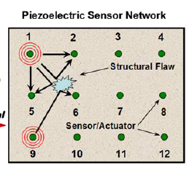
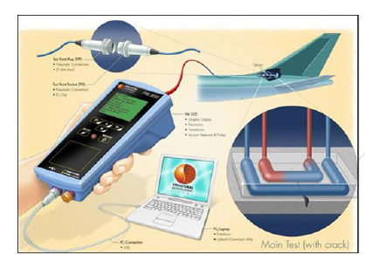
Some SHM technologies for different materials and defects
Piezoelectric actuators/sensors
Carbon Nano tube (increased conductivity, to measure changes)
Eddy current arrays
CVM sensor Comparative Vacuum Monitoring
Strain gages
Metallic cracks , corrosion, delamination, debonding.
Different maturity

Slide 3
ARP6821 probability chapters

Slide 4
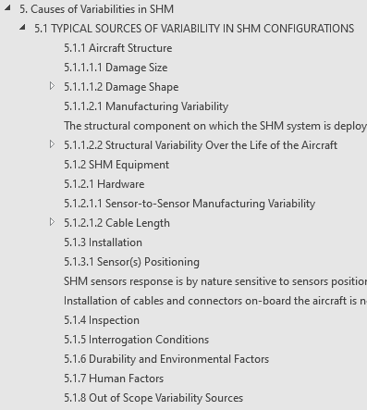
Chapter 5 Sources of variability
Notes:
Sensor calibration.

Slide 5
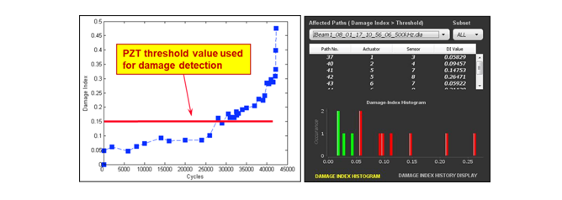
Use of a Damage Index to establish damage detection
Damage indices are the result of engineering development and often proprietary
Notes:
Pass-fail
Image credit: wavelet.png. Wikimedia Commons

Slide 6
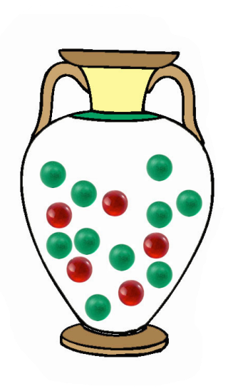
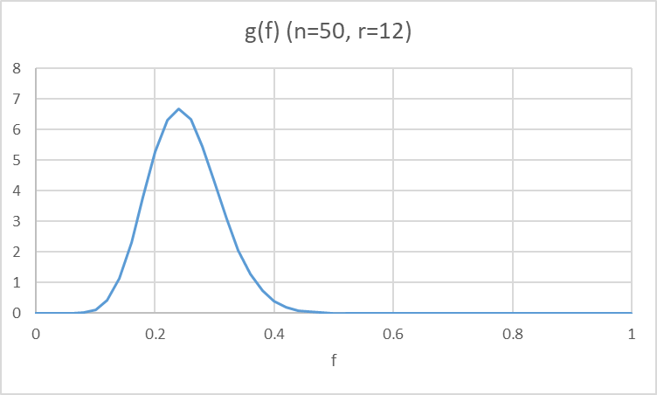
Chapter 7, Statistical methods to evaluate SHM capability
Next step from Appendix G from MIL-HDBK 1823A (for conventional NDI)
29/29 method
Non-parametric method. Pass-fail; ignores the damage index information.
For a certain couple sensor/damage
Sampling Binomial distribution:
Drawing with replacement from an urn with proportion f of red balls (detections)
Prior: Conservatively assume one ball was extracted before and it was green
Inference of f from the number of positives r from a sample n is a beta distribution
alpha=r, beta=n-r+1
If all 29 of a sample of 29 are red (r=n) f>=.9 with confidence 95.3%
g(f|DX)=$\frac{ \left(n\right)!}{(r−1)!\left(n−r\right)!}f^{r−1}{\left(1−f\right)}^{n−r}$
Notes:
Assembly level?

Slide 7
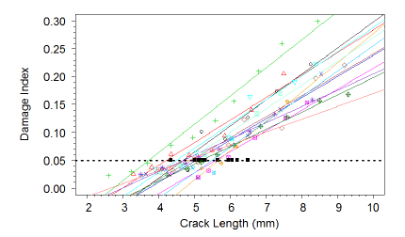
SODAD (Size of Deterioration At Detection)
Focusses attention on detections close to the threshold

Slide 8
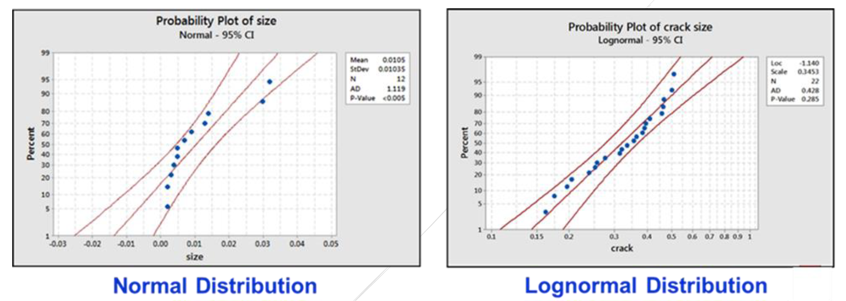
Hypothesis testing: Underlying probability distribution
Family of distributions with best fit.
Visually for ML fit, or analytically for all the weighted parameter combinations
Notes:
Check what each probability is

Slide 9
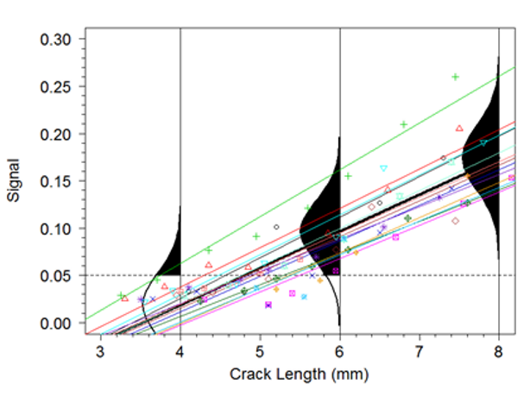
Random Parameter Model
Bayesian approach with weakly informative priors
Notes:
Evolution of the a hat method used for NDI

Slide 10
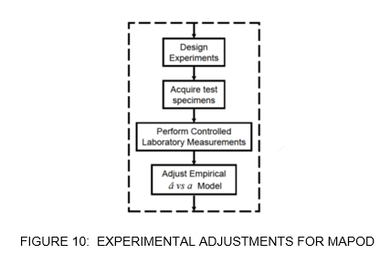
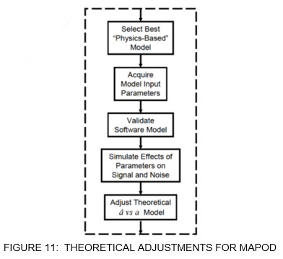
Model Assisted Probability
Model-assisted POD (MAPOD) as defined in MIL-HDBK-1823A as
“Methods for improving the effectiveness of POD models that need little or no further specimen testing”.
Physics-based models of inspection are used to help quantify POD for particular kinds of inspections
Limited development
Technique dependent
Modelling of complex/nonlinear
physical aspects

Slide 11
SHM certification for aeroplanes
Novel application: to monitor parts of difficult access without removing linings, galleys, etc.
Note: Conventional inspection allows to detect cracks in adjacent, unexpected locations
The level of safety should be equivalent to conventional inspections
Notes:
Part M coordination CAMO. What is on the aircraft and on the ground

Slide 12
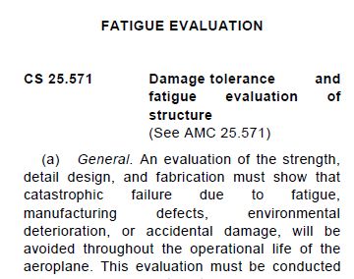
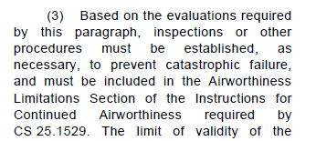
SHM certification for aeroplanes
Applicable regulation. E.g. for large aeroplanes, CS 25.571, 25.611 (accessibility) and 25.1529. Eventually 25.629 (aeroelasticity affected by stiffness)
Detectable crack length
Notes:
Part M coordination CAMO. What is on the aircraft and on the ground

Slide 13
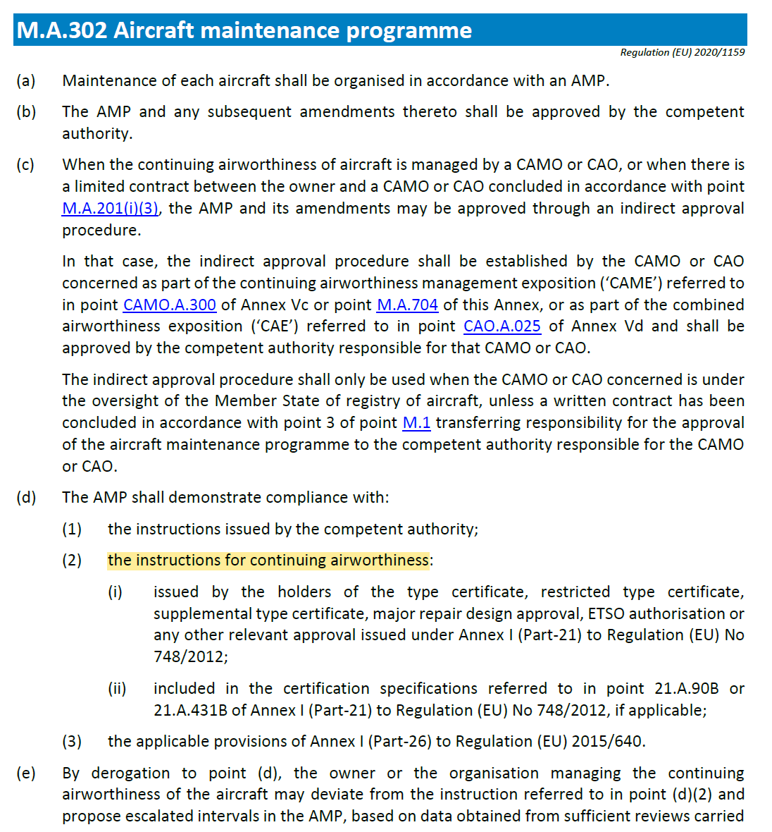
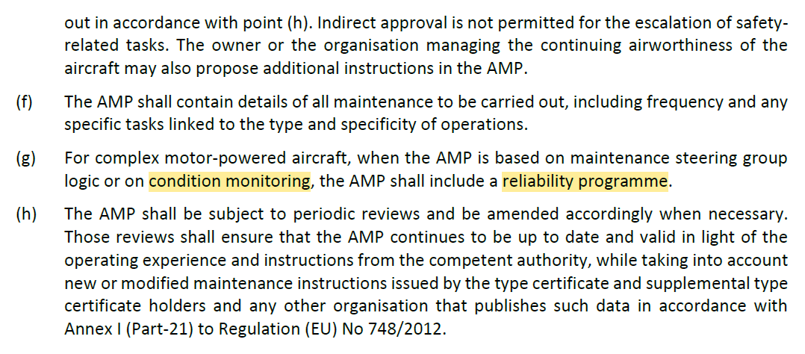
Part M. M.A.302, among other requirements for maintenance organizations
Interface initial airworthiness and maintenance, for ALS and MRBR
ALS: Scheduled or unscheduled maintenance e.g. in case of hard landing or severe usage
Data analysis TC holder vs maintenance organization
Visibility for CAMO

Slide 14
Certification challenges of SHM
Installed vs. ground equipment certification
Qualification and probability of detection on specific configuration. Test pyramid
Design of Experiments. Representativeness of parameter combination
Technology maturity and process control
Knowledge and validation of the critical installation aspects.
Equipment qualification standard
Calibration.
Environmental and Durability tests
Inspector qualification

Slide 15
Sample size
If the technology is sensitive to different sources of variability , the number of experiments will have to increase according to a Design of Experiments
If the technology is sensitive to the geometry and level of assembly, a test pyramid will have to be developed from the coupon to the assembly level, with a link of understanding between levels, preferably with an understanding of the physics

Slide 16
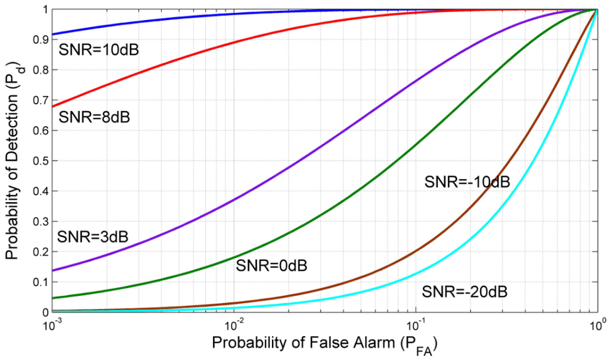
Number of specimens, threshold and detectable damage
Probability of Detection shouldn’t be less than the current objective for NDI in practice :
90% probability with 95% confidence (MIL-HDBK 1823, JSSG-2006)
Uncertainty decreases with the number of specimens (smaller damage detection)
Variability is inherent to the design and its implementation
Reducing uncertainty
Robust step by step implementation and test pyramid
Process for test sequence, as for NDI
Increase number of configurations tested
Increase number of pairs sensor/damage.
Trade-off development and operation cost
Threshold established to not only limit missed damages, but also ensure there aren’t too many false alarms. Cost and safety issue
Depending on signal to noise ratio.
Mathematical complexity of damage indexes

Slide 17
Maturity steps
Sequential phases of characterization and operational increasing risk, to gain confidence
1. Double-check existing crack with redundant inspections
2. SHM only. No cracks allowed
3. SHM only crack growth monitoring (flight with known cracks)
Flight with known cracks.
Last maturity step
Currently the baseline is that a crack should be repaired except in exceptional circumstances and with a number of conditions including UL capability
Policy to be complemented to consider awareness of well controlled cracks with a long margin to become critical
However important considerations:
Crack and spectrum well understood
Other opportunities for detection (e.g. visual)
System capable to identify crack geometry
Single vs multiple load path
Residual strength and life

Slide 18
Thank you!

