Slide 1


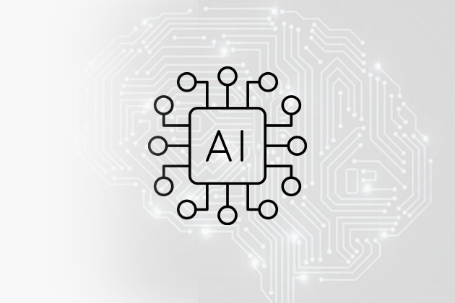
A Deep Learning based pipeline for online Remaining Useful Life diagnostics & prognostics
Giannis Stamatelatos – PhD candidate
Theodoros Loutas – Professor

Slide 2
Introduction
Problem definition
How SHM measurements (e.g. strain, guided waves, acoustic emission) can be used for diagnosis and prognosis.
Developing a Deep Learning AI pipeline that is universally applicable and practically feasible wherever a sensor network is available.
Objectives
Diagnosis
Train a deep learning model to assess the current Stiffness of a structure in real time.
Prognosis
Train a second model to estimate the Remaining Useful Life of a structure in real time.

Slide 3
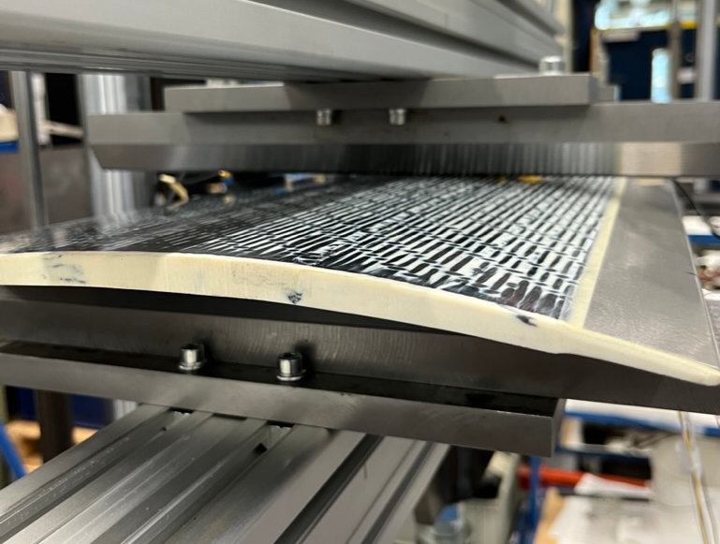
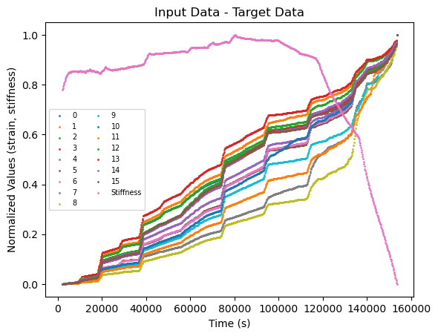
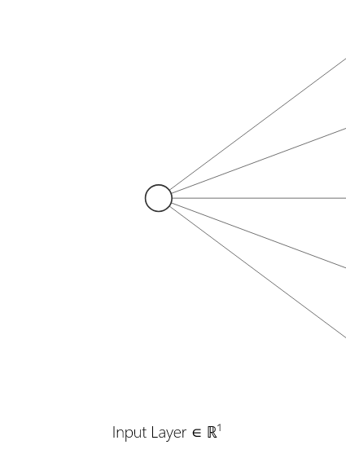
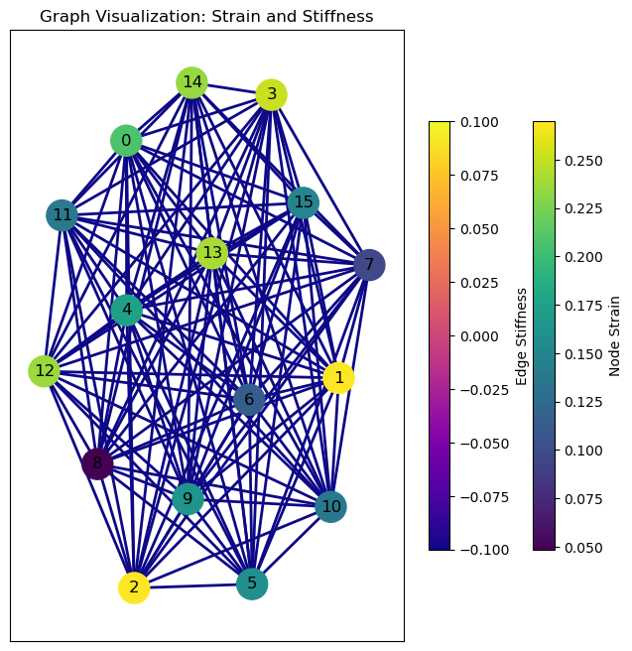
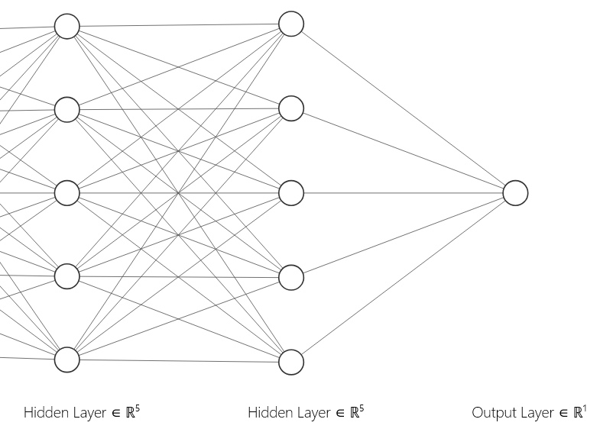
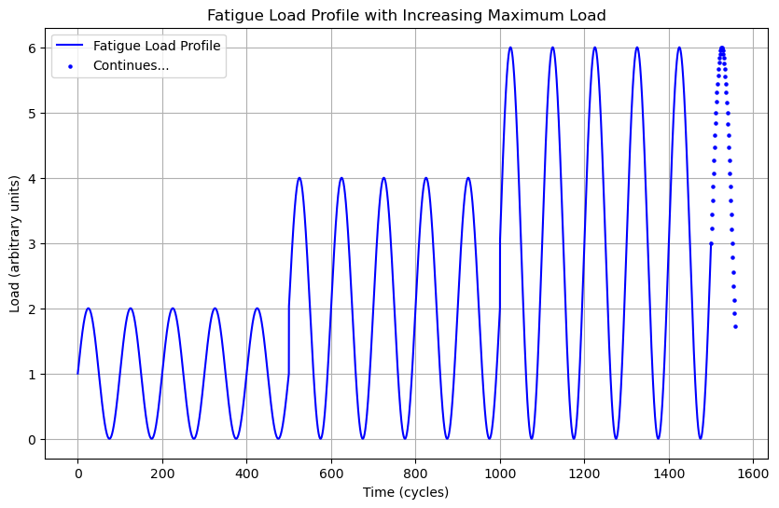
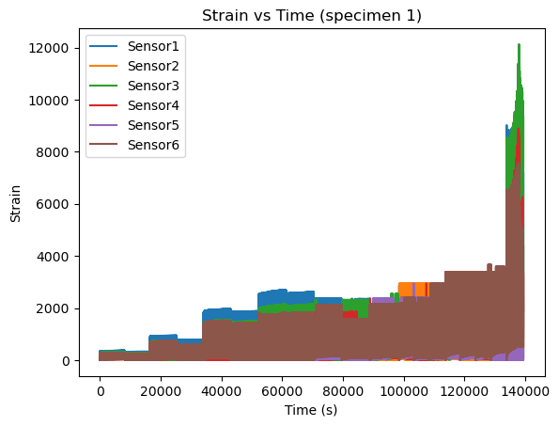
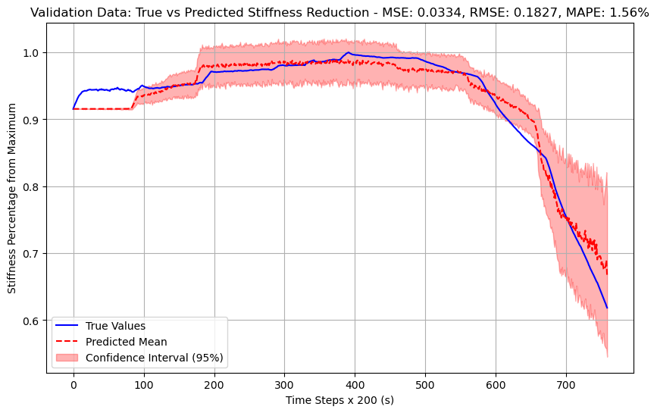
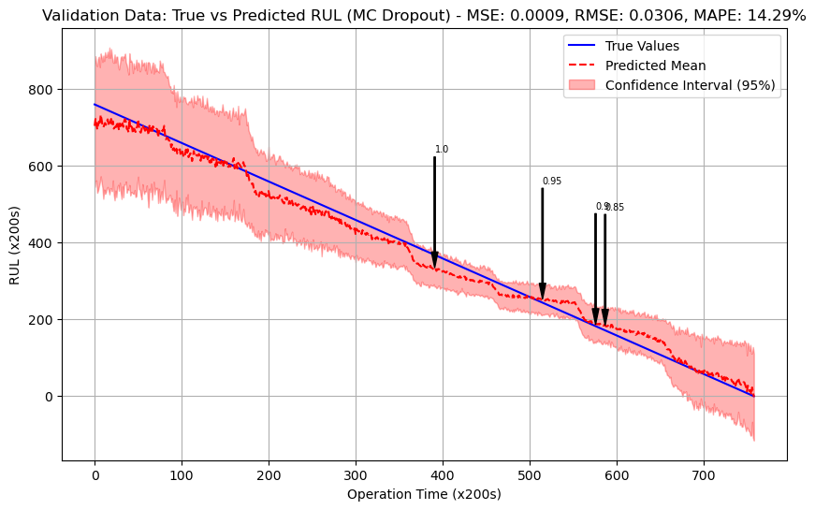
RUL Prediction and Stiffness Assessment Pipeline
Generic aircraft element
Extracted Features – Preprocessing
Deep Learning Graph Neural Network
Global Mean Pool
Graph NN
Fatigue Load Profile
Raw Strain Data

Slide 4
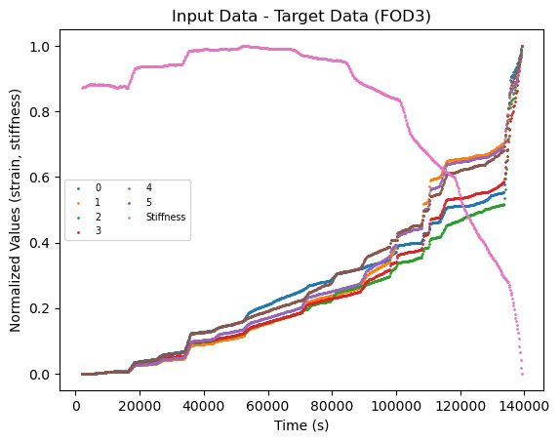
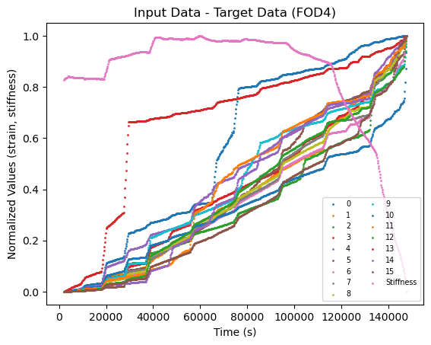
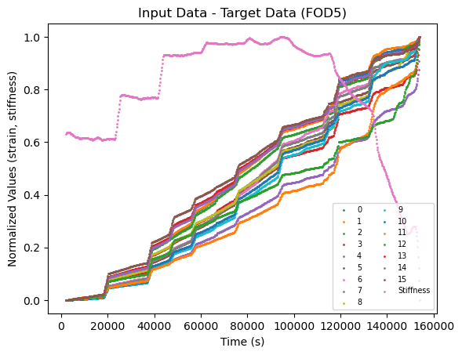
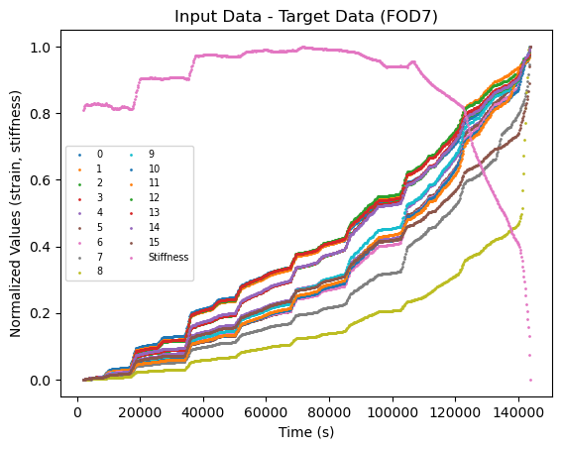
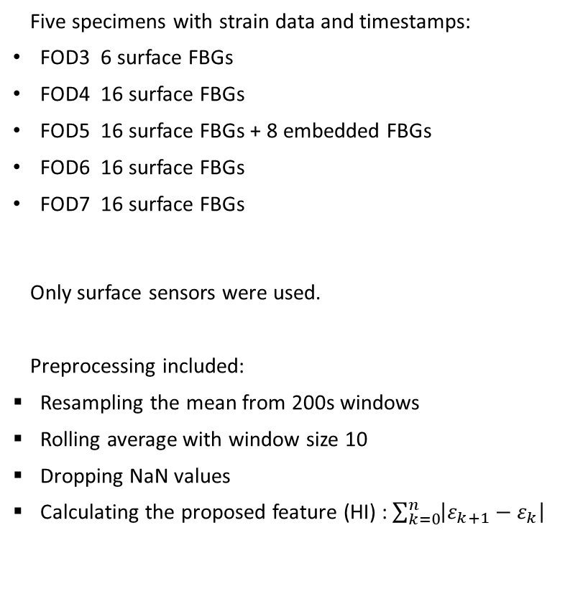
Available Strain Data and Preprocessing
Five specimens with strain data and timestamps:
FOD3 6 surface FBGs
FOD4 16 surface FBGs
FOD5 16 surface FBGs + 8 embedded FBGs
FOD6 16 surface FBGs
FOD7 16 surface FBGs
Only surface sensors were used.
Preprocessing included:
Resampling the mean from 200s windows
Rolling average with window size 10
Dropping NaN values
Calculating the proposed feature (HI) : $\sum_{k=0}^{n}{\left|ε_{k+1}−ε_{k}\right|}$
Post-processed strain and stiffness vs time

Slide 5
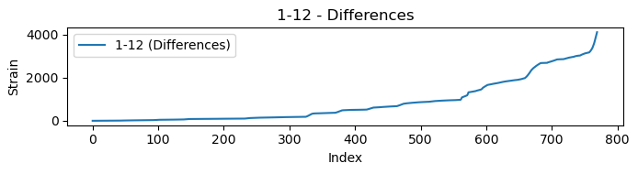
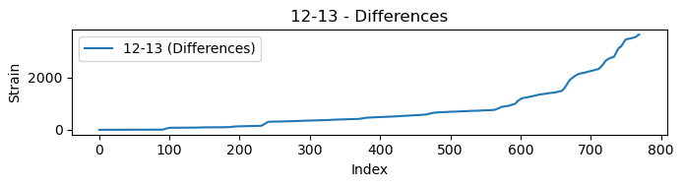
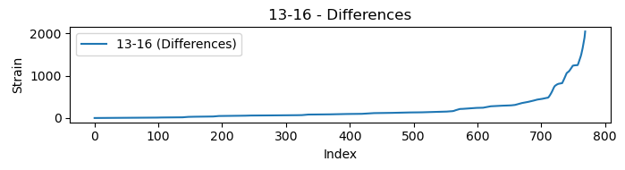
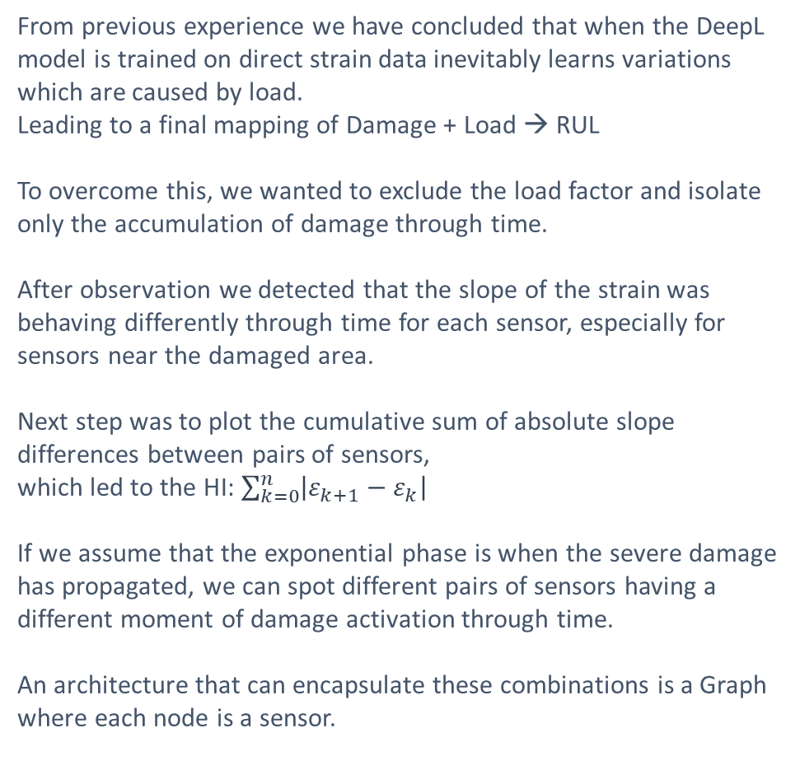
Intuition before modeling
From previous experience we have concluded that when the DeepL model is trained on direct strain data inevitably learns variations which are caused by load.
Leading to a final mapping of Damage + Load → RUL
To overcome this, we wanted to exclude the load factor and isolate only the accumulation of damage through time.
After observation we detected that the slope of the strain was behaving differently through time for each sensor, especially for sensors near the damaged area.
Next step was to plot the cumulative sum of absolute slope differences between pairs of sensors,
which led to the HI: $\sum_{k=0}^{n}{\left|ε_{k+1}−ε_{k}\right|}$
If we assume that the exponential phase is when the severe damage has propagated, we can spot different pairs of sensors having a different moment of damage activation through time.
An architecture that can encapsulate these combinations is a Graph where each node is a sensor.
HI
HI
HI
Pairs of differences of the proposed HI

Slide 6
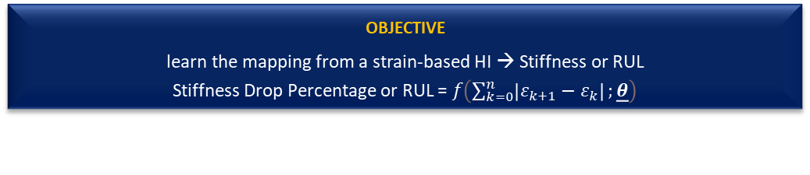
Proposed Graph Neural Network Model
Overview:
The GNN model is designed for graph-based regression or classification tasks, where each node in the Graph represents a sensor with strain data as features. It leverages the structure of graph data to learn complex relationships between nodes.
Architecture:
Input Layer:
Node Features: Each node (sensor) receives features (HI).
Edge Information: Captures relationships between nodes.
Graph Convolutional Layers:
Layer 1 (GCNConv): Applies graph convolution to aggregate information from neighboring nodes.
Activation: ReLU (Rectified Linear Unit) introduces non-linearity.
Dropout: Regularization technique to prevent overfitting.
Layer 2 (GCNConv): Further processes the aggregated node features.
Global Mean Pooling: Combines node features into a single graph-level representation by averaging.
Fully Connected Layers:
Hidden Layer: Further processes the pooled features with ReLU activation.
Output Layer:
Produces the final regression output.
Global Mean Pool
Graph NN
OBJECTIVE
learn the mapping from a strain-based HI → Stiffness or RUL
Stiffness Drop Percentage or RUL = $f\left(\sum_{k=0}^{n}{\left|ε_{k+1}−ε_{k}\right|};\underline{θ}\right)$
Suitable for tasks where data is represented as graphs, such as sensor networks, social networks, and molecular structures.

Slide 7
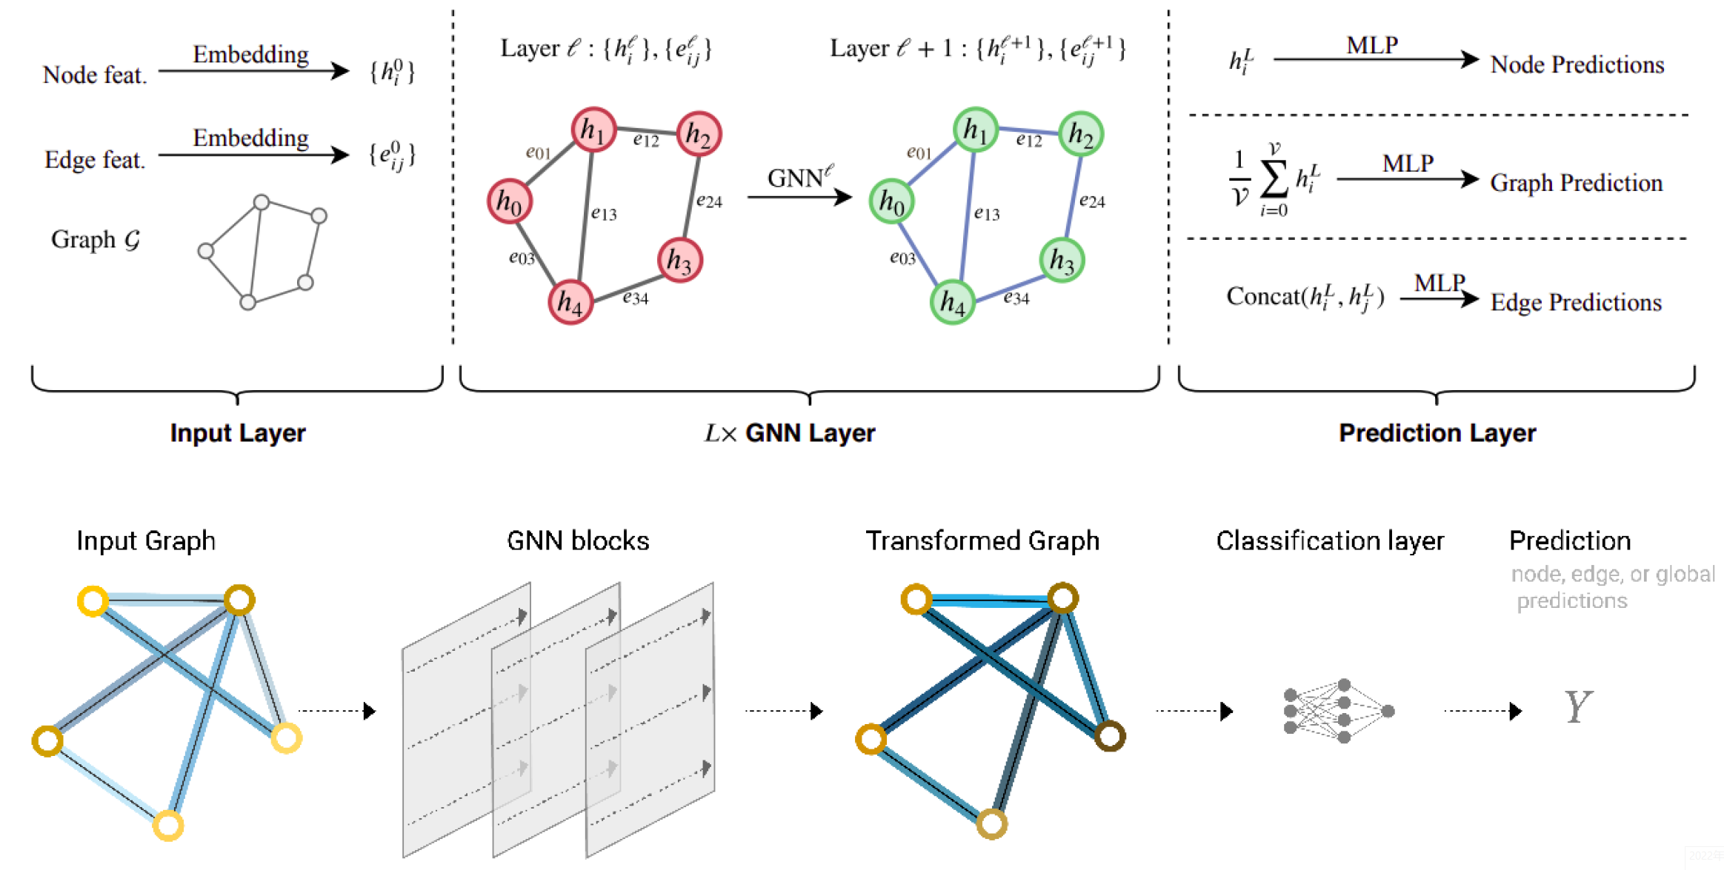
Graph Neural Network Explained
What is a Graph Neural Network?
Graph Neural Networks (GNNs) are advanced deep learning models designed to operate on graph-structured data. They effectively capture the relationships between nodes, allowing for rich representations that leverage both the features of individual nodes and the overall graph structure.
Main Pillars of GNNs
Message Passing:
How It Works: Nodes exchange information with neighbors, collecting messages to update their representations based on local context.
What It Does: Enables learning from connectivity and relationships, crucial for spatial arrangements like sensor networks.
2.Node Update with Neural Networks:
How It Works: Nodes update their feature representations using neural network layers, such as the Graph Convolutional Network (GCNConv), processing aggregated messages.
What It Does: Refines node representations through learned transformations, facilitating complex interactions within the graph.
3.Aggregation:
How It Works: Nodes aggregate incoming messages using functions like summation, mean, or max pooling.
What It Does: Creates a collective understanding of the local neighborhood, ensuring updated representations reflect connected nodes' influences

Slide 8
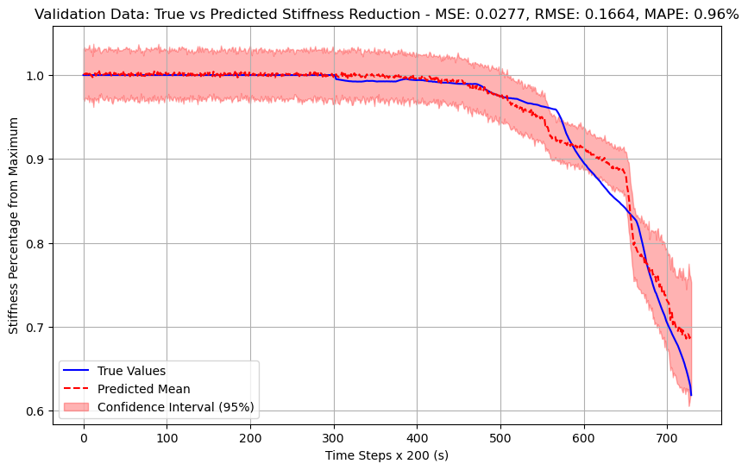
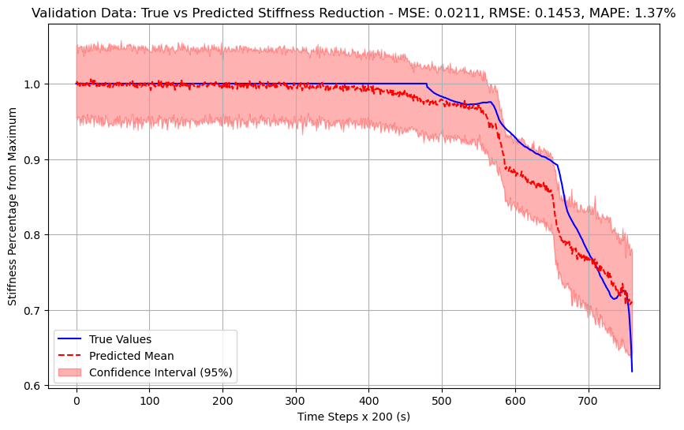
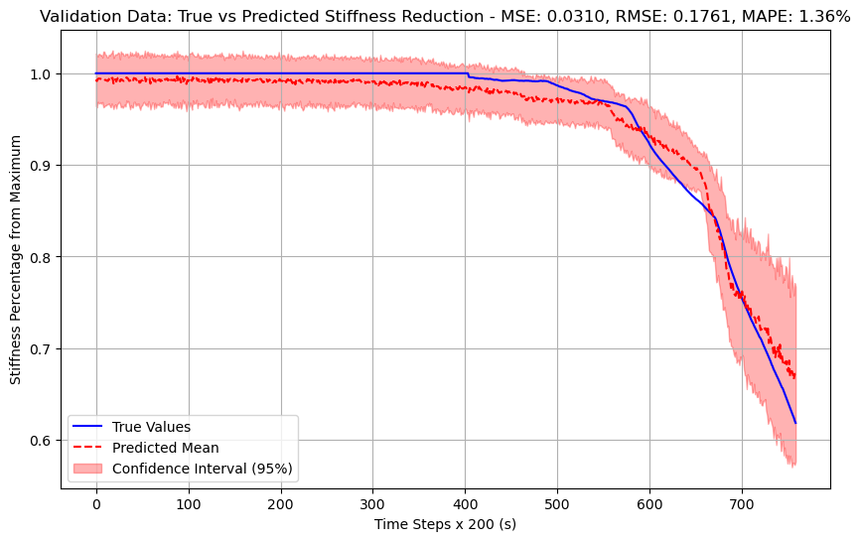
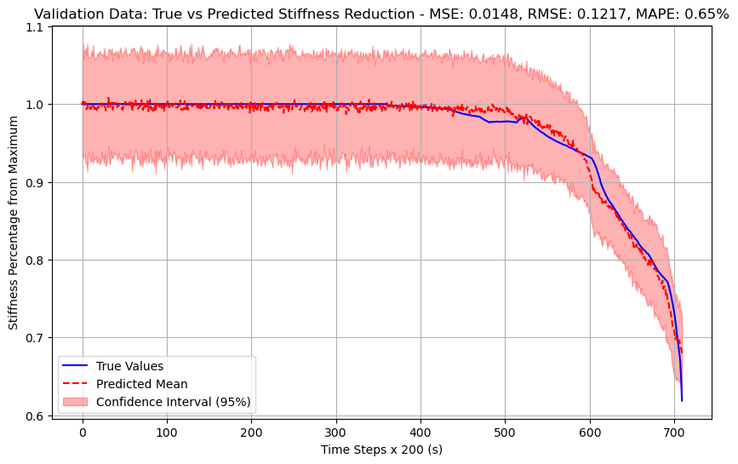
Stiffness Assessment with K-fold cross validation
In each fold a single specimen is left out from the training set. Each of the 4 plots represent the unseen specimen used for inference in each fold.
  The mean metrics are :
  MSE: 0.0236
  RMSE: 0.1528
  MAPE: 1.08%
FOD4
FOD5
FOD5 is the only specimen where artificial damage has not been inflicted a priori. Model underestimates stiffness since has only seen a priori damaged specimens.
Also we observe at 85% stiffness, all k-fold models converge to the true value with minimum variance.
FOD6
FOD7

Slide 9
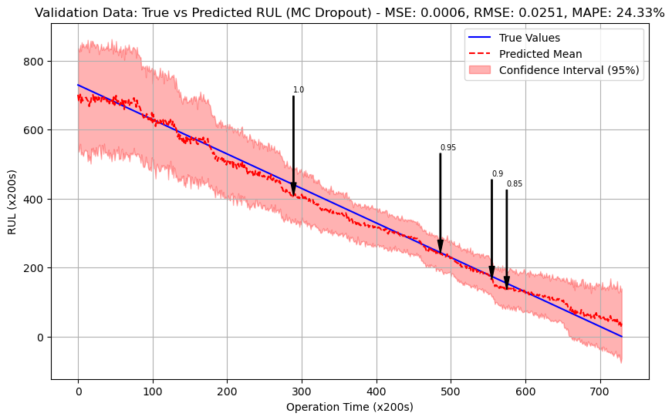
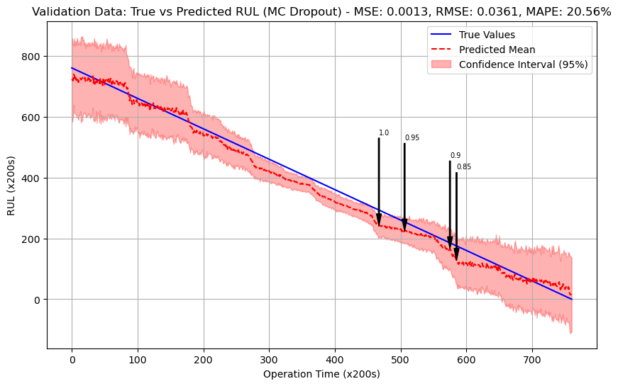
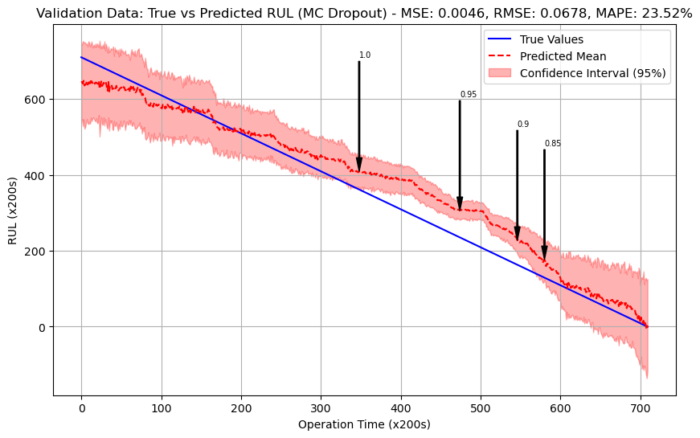
K-fold cross validation – RUL Estimation to EOL
  The mean metrics are :
  MSE: 0.0018
  RMSE: 0.0399
  MAPE: 20.67%
Black arrows correspond to Stiffness levels: 100% , 95%, 90% and 85% respectively.
Model is trained with data until EOL.
FOD4
FOD5
FOD6
FOD7

Slide 10
Stiffness and RUL 1 by 1 comparison
FOD4
FOD5

Slide 11
Stiffness and RUL 1 by 1 comparison
FOD6
FOD7

Slide 12
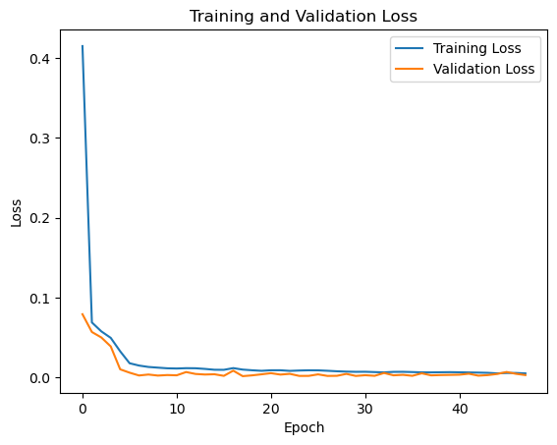
Hyperparameters and Training
Parameter (total layers) | Value
Pre-message Layers (#) | Linear (1)
Graph Layers (#) | GCNConv (2)
Post-message Layers (#) | Linear (2)
Hidden Dim | 12
Activation function | Leaky ReLU
Dropout | 0.2
Learning rate | 0.01
Learning rate scheduler | ReduceLROnPlateau
Scheduler’s patience epochs | 10
Scheduler’s decay factor | 0.1
Early stop patience epochs | 30
Optimizer | Adam
Batch size | 128

Slide 13
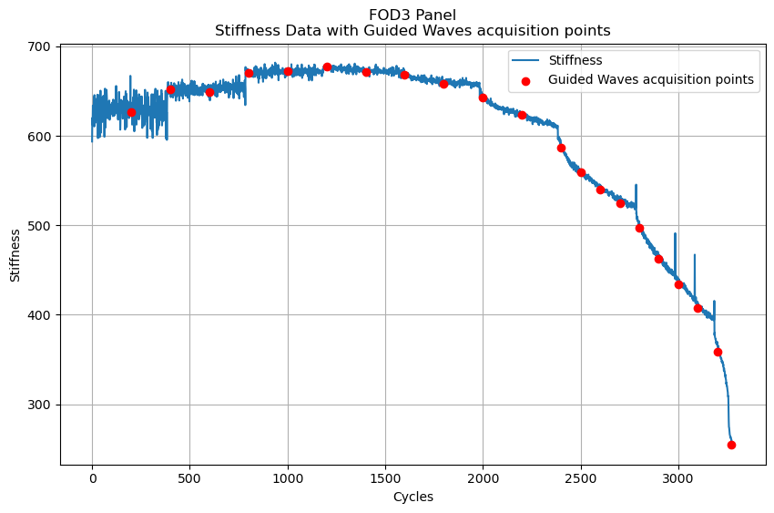
Guided Waves Deep Learning Pipeline Plans
Each acquisition point includes 5 different frequency excitations
Finally, 4 repetitions are made for each combo
50kHz | 100kHz | 150kHz | 200kHz | 250kHz
Act. 1 | Act. 1 | Act. 1 | Act. 1 | Act. 1
Act. 2 | Act. 2 | Act. 2 | Act. 2 | Act. 2
Act. 3 | Act. 3 | Act. 3 | Act. 3 | Act. 3
Act. 4 | Act. 4 | Act. 4 | Act. 4 | Act. 4
Each Actuator
Rep. 1
Rep. 2
Rep. 3
Rep. 4
In each frequency: 1 actuator excites and 3 are receiving cycling through all 4 actuators
Actuators
2
Total signals for each point:
5 (freq.) x 4(act.comb.) x 10(reps.) = 200
4
1
3

Slide 14
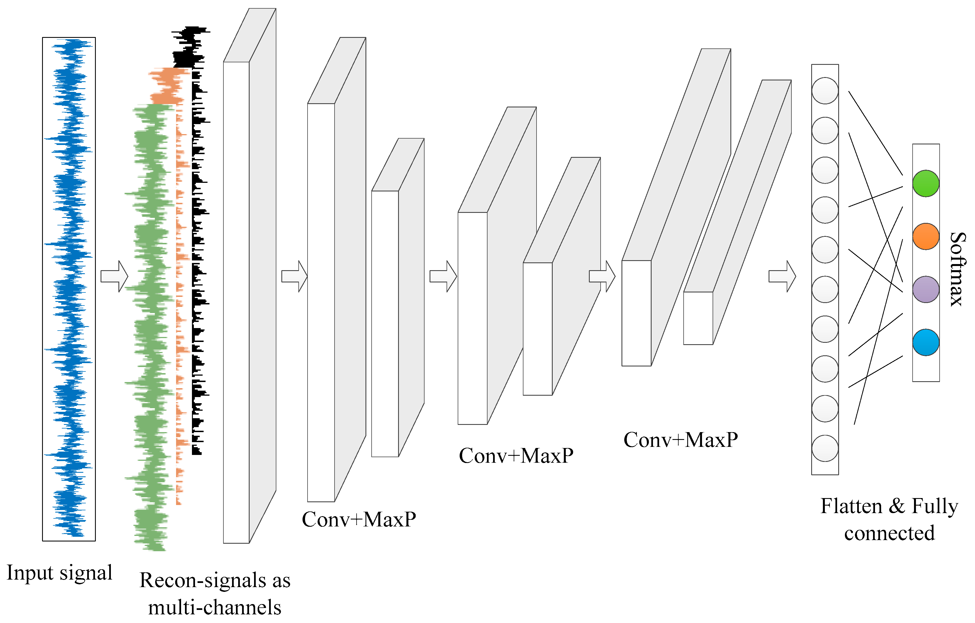
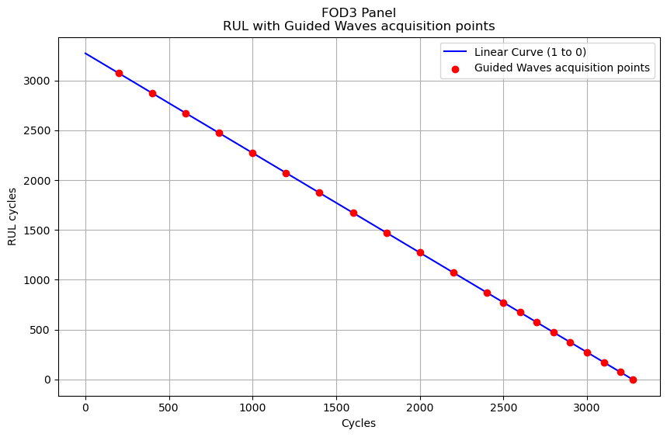
Guided Waves Deep Learning Pipeline Plans
1 of 80 signals
Output layer can either be a softmax for classification or a Linear layer for regression
1D Convolutions

Slide 15
Conclusion
Graph Deep Learning Neural Network model displays its capability to generalize astonishing well on “unseen” data.
The intuition of how the combinations of different sensor are affecting the target values seems to work.
It can work online , on real-time to predict the RUL of an operational structure or the current stiffness.
Pipeline exists to incorporate new specimens and augment the dataset on the fly.
Same pipeline can be used for all kind of structure as soon as some data are available for training.
The Graph Network demonstrates its extraordinary capability to learn from as few as 3 specimens.
The training and validation loss curves showed a stable, slightly underfitting process, as intended, since the objective was to avoid overfitting for safer generalization.

Slide 16
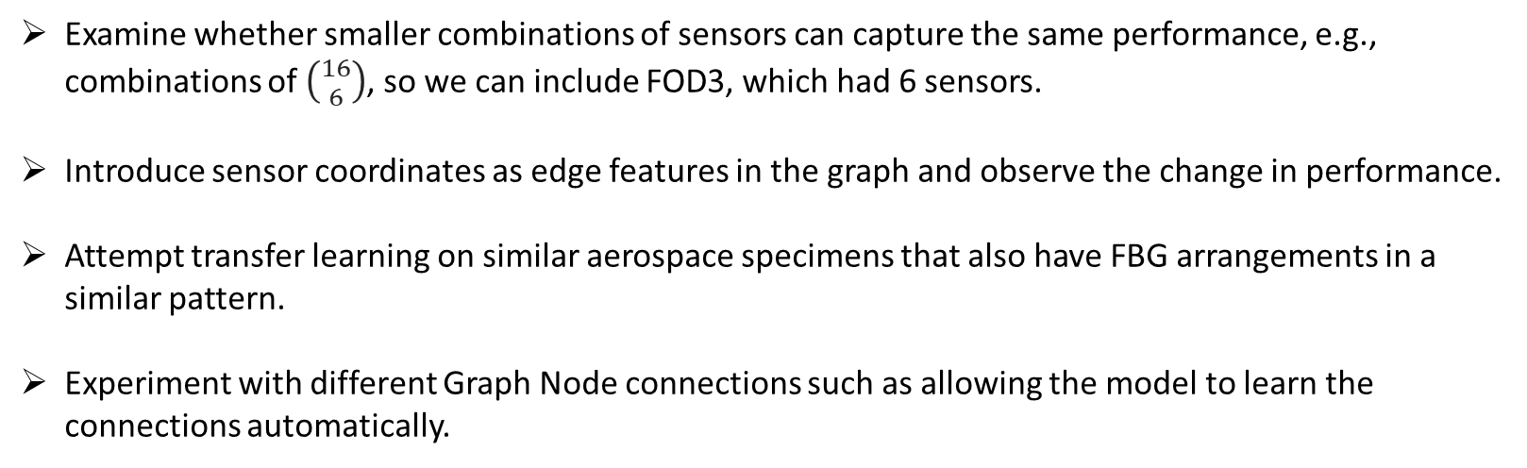
Future Plans
Examine whether smaller combinations of sensors can capture the same performance, e.g., combinations of $\left({16 \atop 6}\right)$, so we can include FOD3, which had 6 sensors.
Introduce sensor coordinates as edge features in the graph and observe the change in performance.
Attempt transfer learning on similar aerospace specimens that also have FBG arrangements in a similar pattern.
Experiment with different Graph Node connections such as allowing the model to learn the connections automatically.

Slide 17







