Slide 1

EASA - MORPHO
Workshop
November 2024 (virtual)
Certification Notes
S. Waite: EASA Senior Expert - Materials
Certification Directorate

Slide 2
EASA – MORPHO
Certification Notes:
Reminder:
this is not a certification (although potentially most value may result from treating it as such)
composite fan blades already certified
materials/AHM/SHM technologies evolving rapidly
many existing related and established cross product activities, e.g. engines, rotorcraft, and now large pax SHM, e.g. SAE
EASA information/presentations shared with MORPHO, e.g. APRIL 2023 SAE CACRC SHM
Note: ‘open rotors’ are a challenge, particularly the blade release issue (EASA IPC* started, 2024 reengagement effort likely 2024)… other mitigations expected in addition to those identified for fan blades
Note: although composite fan blades have been certified, they could potentially been used to provide technology for ‘open rotors’ … TBD
Note: also related CBM related IPCs in progress
*IPC – Innovation Partnership Contract

Slide 3
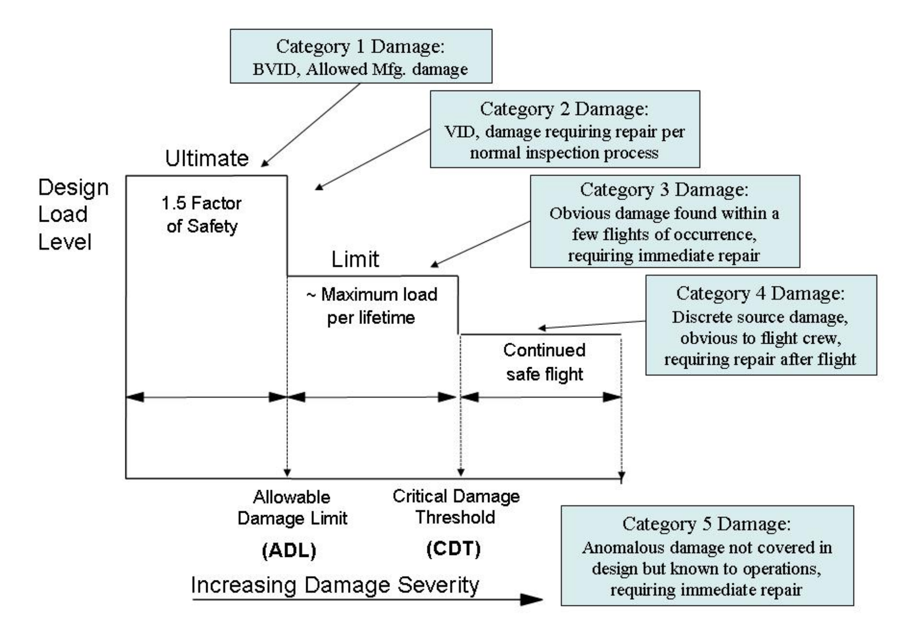
EASA – MORPHO
Certification Notes – Structures and Engines related regulations:
Building Blocks – Structures /Materials/’Engineering Properties’:
CS25.603, 605, 613 amdt 27
CS25. 571 (F&DT)
CS E-70, E-810
AMC 20-29 ‘Composite Structures’
- CMH-17 Rolls Royce presentation (2017)regarding damage categories
(to be adapted for engines?, future CMH-17 revision?)
- EASA Composite Fan Blade Certification Review Item (CRI) (using AMC 20-29, see support slides)
Design, e.g.
- impact of sensors upon Modelling and Simulation, and necessary substantiation test and analysis pyramid definition? Anisotropy and competing failure modes suggests need for more testing, not less!
Regulations addressing design, manufacture, and in-service considerations… to be supported by ‘Threat Assessment’
Manufacturing, e.g.
correlation of embedded sensor or tool senor data with engineering properties?
In-service, e.g.
- impact of sensors upon ‘engineering properties, e.g. strength, stiffness, fracture toughness, fatigue etc?

Slide 4





EASA – SAE CACRC
Note: Recent CS25 amdt.19… (following increased use of composites)
need for thorough ‘Threat Assessment’…
‘manufacturing defects’ added…
manage an embedded sensor as a flaw/anomaly within specifications, not a defect?
previously referenced ‘corrosion’, not ED
Example* regulation evolving with technology (CS Level):
CS25.571: Damage-tolerance & fatigue evaluation of structure
‘(a) General. An evaluation of the strength, detail design, and fabrication must show that catastrophic failure due to fatigue, manufacturing defects, environmental deterioration (ED), or accidental damage (AD) will avoided throughout the operational life of the aeroplane…’
‘(3)…..inspections or other procedures must be established as necessary to prevent catastrophic failure, and must be included in the Airworthiness Limitations Section of the Instructions for Continued Airworthiness required by CS 25.1529’
Note: Does not need to be visual, or an inspection (process monitoring, SHM etc?)
need to find, define, and bound damage…
applies to baseline structure, modifications, and repairs

Slide 5
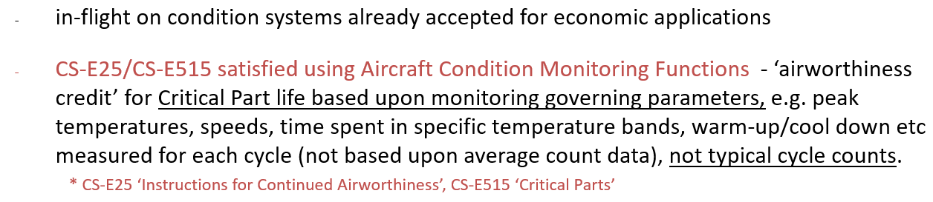
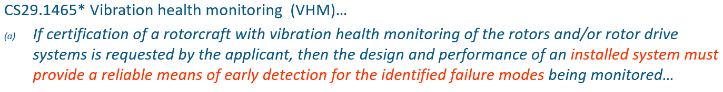
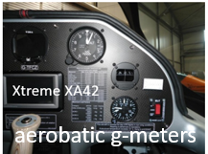
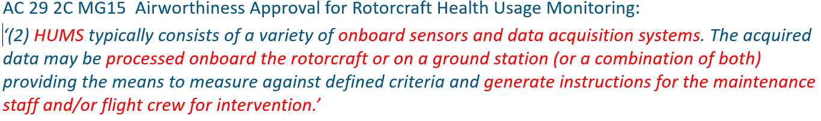
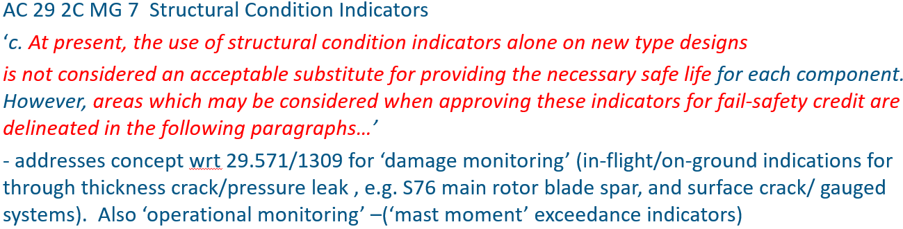
EASA – SAE CACRC
applies to baseline structure, modifications, and repairs
EASA - Structural Health Monitoring and Management
  SHM, and similar technologies, not new to aviation… or certification
  engines
  rotorcraft
  GA
use ‘lessons learned’!
Driven by Design Certification

Slide 6
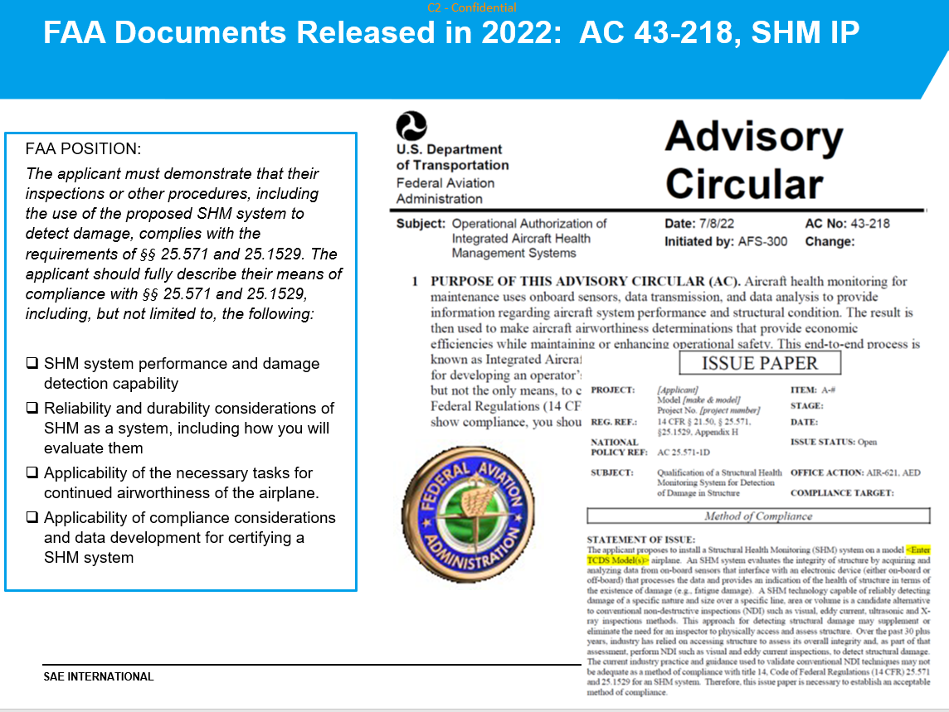
EASA – MORPHO
Certification Notes:
Building Blocks – AHM/SHM etc
Engines: CS E-515 ‘Condition Monitoring’
Rotorcraft: CS29.1495 ‘Vibration Health Monitoring’, AC27/29
Large Pax Aircraft CS 25.302 (Systems Structure Interaction)
FAA - AC43-218 (operational issues), FAA IP (certification issues), SAE SHM AIRs and ARPs
various FAA SHM applications submitted, e.g. B737 RPB local crack detection, antenna interface with baseline structure etc
various EASA projects in progress (e.g. ‘equivalent’ life counting)
many other R&D related projects, e.g. equivalent life counting etc (many associated with AI, Digital Twins, Big Data, ML etc)

Slide 7
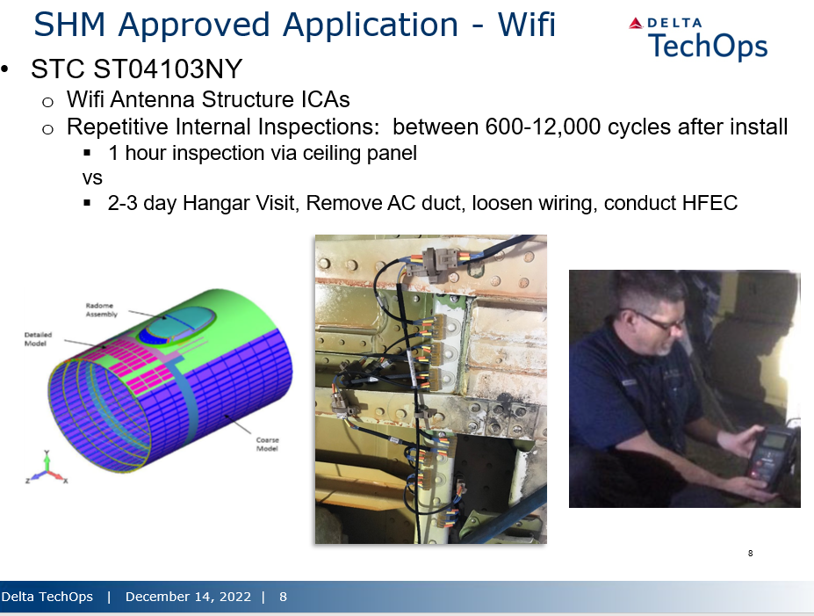
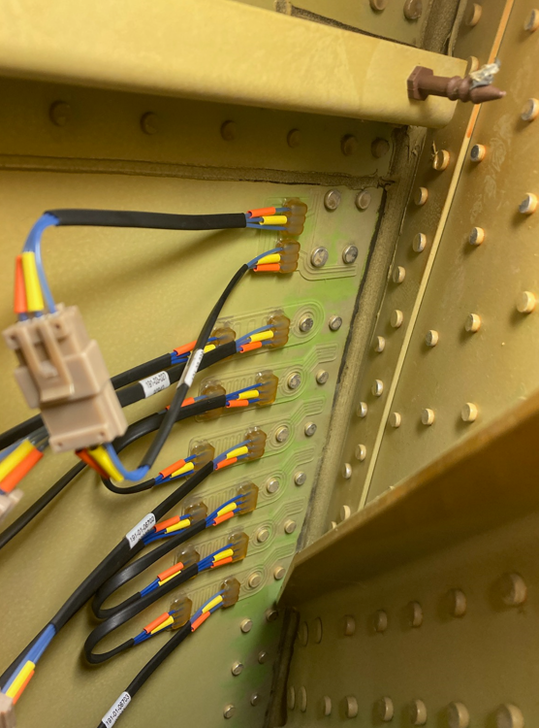
EASA – SAE CACRC
Other regulations and guidance – Airframe SHM:
B737 Rear Pressure Bulkhead – CVM attached to metallic structure
(EASA Task No. 60087006)
TBC

Slide 8
SHM - Summary
progressive ‘small steps’ expected (regarding application criticality and complexity), e.g. certification of a generic inflight damage detection SHM tool is likely to be significantly more challenging than an application focused upon a known single damage mode/location, or simple load exceedance measurement, or simple cycle counting etc, using periodic on ground data review…
‘small steps’ in parallel with, and not compromising, existing airworthiness process, e.g. via the modification process
use appropriate experience from across technical disciplines and product ranges, e.g. rotorcraft and engine experience is arguably ahead of airframe etc
Note: current developing certification projects are taking this approach
571
S.Waite
Senior Expert - Materials
Certification Directorate571

Slide 9
SHM - Summary
safety challenges – reliability (POD detection and system reliability), competing damage modes, correlation with residual strength (or other hazards), statistics
regulatory process likely to involve elements of existing regulations + other regulatory tools, e.g. Certification Review Items (CRIs), Special Conditions (SCs) etc.
‘Performance’ based regulation is likely to rely more upon industry guidance when considered to be acceptable to the regulators
discuss intentions early with the regulators
Note: there exist various EU R&D SHM projects/project proposals in various states of maturity
571
S.Waite
Senior Expert - Materials
Certification Directorate571

Slide 10
EASA - SHM
EASA – IVHM, SHM etc co-ordination - across product and discipline initial contacts:
VHM*/IVHM Rodrigo Martin – Transmission and Structures Expert (GA & VTOL) rodrigo.martin-gomez@easa.europa.eu
AI/ML Guillaume Soudain – Programme Manager - AI
guillaume.soudain@easa.europa.eu
Systems TBD
Software/Hardware Dietmar Freese – Software and Airborne Electronic Hardware Expert (Propulsion dpt)
Dietmar.FREESE@easa.europa.eu
Propulsion Omiros Kastanis - Propulsion Expert
omiros.kastanis@easa.europa.eu
Structures Wolfgang Hoffmann – Structures Expert (Large Aeroplanes)
wolfgang.hoffmann@easa.europa.eu
ICA Markus Janischowsky – Instructions for Continued Airworthiness - Senior Expert
markus.janischowsky@easa.europa.eu
Aircraft Maintenance Ralf Schneider – Aircraft Maintenance Expert
ralf.schneider@easa.europa.eu
Statistics Elena Garcia Sanchez – Structures Expert
elena-beatriz.garcia-sanchez@easa.europa.eu
Modelling and Simulation Wim Doeland – Structures Large Aeroplanes - Senior Expert
willem.doeland@easa.europa.eu
* VHM - Vibration Health Monitoring
Note: EASA Design and Production Organisation contacts to be added later, subject to need

Slide 11

Questions ?

Slide 12
Support Slides

Slide 13
EASA – MORPHO
Certification Notes:
Composite Fan Blade CRI (example content elements):
Laminated composite engine fan blades have already been certified in the past. For every concerned project the JAA or EASA have prescribed a Special Condition. EASA has in June 2007 published for public consultation a Special Condition addressing the composite fan blade containment….
Special Condition, in order to establish a level of safety equivalent to the one required by CS-E 810 for turbine engines with metallic fan blades, and in compliance with Part 21A.16B(a)1. and Part 21A.16B(b), the following Special Condition shall be applied to the XXX Engine:
For compliance with CS-E 810, in lieu of the fan blade containment test with the fan blade released at the top of the retention member as specified in the AMC E 810 (2)(b)(i), ….complete the following requirements:
  conduct an engine fan blade containment test with the fan blade released at the inner annulus flow path line;
  substantiate by test and analyses, or other methods acceptable to the Authority, that a minimum material properties fan disk and fan blade retention system can withstand without failure a centrifugal load equal to twice the maximum load which the retention system could experience within approved engine operating limitations;

Slide 14
EASA – MORPHO
Certification Notes:
Composite Fan Blade CRI (example content elements):
Using a procedure accepted by the Authority, establish an operating limitation that specifies the maximum allowable number of start-stop stress cycles for the fan blade retention system. The life evaluation shall include the combined effects of high cycle and low cycle fatigue. If the fan blade Approved Life is less than 100,000 start-stop stress cycles, that Approved Life must be published as required in CS-E 25(b). The fan blade retention system includes the portion of the fan blade from the inner annulus flow path line inward to the blade dovetail, the blade retention components, and the fan disk and fan blade attachment features.
Substantiate that, during the service life of the engine, the total probability of the occurrence of a Hazardous Engine Effect defined in CS-E 510 due to an individual blade retention system failure from all possible causes will be Extremely Improbable, with a calculated probability of failure of less than 10E-9 per engine flight hour.
Substantiate by test or analysis that a lightning strike on the composite fan blade structure will not prevent continued safe operation of the affected engine.
Account for the effects of in-service deterioration, manufacturing variations, minimum material properties, and environmental effects during the tests and analyses required by paragraphs (a)(1), (a)(2), (a)(3), (b) and (c) of this Special Condition.
Propose a fleet leader sampling program for the engine fan blades that will monitor the effects of usage on the fan blade and on the retention system integrity. This fleet leader sampling program must be accepted by the Authority prior to Engine certification.

Slide 15
EASA – MORPHO
Certification Notes:
Composite Fan Blade CRI (example content elements):
List the fan blade as an Engine Critical Part and indentify it in accordance with Part 21A.805.
With the exception of (f) above, this Special Condition is not new and is similar to the one published by EASA in 2007 in accordance with the EASA Management Board Decision 12-2007 amending the products certification procedure. A new publication is considered not necessary.
In relation with the Special Condition defined in this CRI, EASA offers the following guidance:
EASA expects that the procedure which is used to establish the fan blade Approved Life will be articulated around:

Slide 16
EASA – MORPHO
Certification Notes:
Composite Fan Blade CRI (example content elements):
An Engineering Plan, the execution of which establishes and maintains that the combinations of loads, material properties, environmental influences and operating conditions, including if necessary the effects of parts influencing these parameters, are sufficiently well known or predictable, by validated analysis, test or service experience. Appropriate damage tolerance assessments must be performed to address the potential for Failure from material, manufacturing and service-induced anomalies.
A Manufacturing Plan which identifies the specific manufacturing constraints necessary to consistently produce the fan blade with the Attributes required by the Engineering Plan.
A Service Management Plan which defines in-service processes for maintenance and repair of the fan blade and which will maintain Attributes consistent with those required by the Engineering Plan. These processes must become part of the instructions for continued airworthiness. The Service Management Plan also includes the a fleet leader sampling program required by the Special Condition.

Slide 17
EASA – MORPHO
Certification Notes:
Composite Fan Blade CRI (example content elements):
If the fan blade Approved Life is based on cyclic testing of parts, the test results should be corrected for inherent fatigue scatter. The test results should be reduced statistically to express the results in terms of a minimum capability.
This CRI requires that the fan blade retention system - including the fan disc - meets a less than 10E-09 failure probability. EASA believes this is a more stringent requirement than the Engine Critical Part one. EASA therefore thinks that appropriate design features are necessary in addition to compliance of the fan disk with CS-E 515 for XXX to show that an individual blade retention system failure from all possible causes will be Extremely Improbable.

Slide 18
EASA – MORPHO
Certification Notes:
Composite Fan Blade CRI (example content elements):
EASA AMC 20-29 Composite Aircraft Structure: This AMC provides guidance for the airworthiness certification of composite aircraft structures. Guidance information is also presented on the closely related design, manufacturing and maintenance aspects.

Slide 19
EASA – MORPHO
Certification Notes:

Slide 20
EASA – SAE CACRC
Example* regulation evolving with technology (CS Level):
CS25.571: Damage-tolerance & fatigue evaluation of structure
‘(a) General. An evaluation of the strength, detail design, and fabrication must show that catastrophic failure due to fatigue, manufacturing defects, environmental deterioration (ED), or accidental damage (AD) will avoided throughout the operational life of the aeroplane…’
‘(3)…..inspections or other procedures must be established as necessary to prevent catastrophic failure, and must be included in the Airworthiness Limitations Section of the Instructions for Continued Airworthiness required by CS 25.1529’
Note: Recent CS25 amdt.19… (following increased use of composites)
need for thorough ‘Threat Assessment’…
‘manufacturing defects’ added…
manage an embedded sensor as a flaw/anomaly within specifications, not a defect
previously referenced ‘corrosion’, not ED
Note: Does not need to be visual, or an inspection (process monitoring, SHM etc?)
need to find, define, and bound damage…
applies to baseline structure, modifications, and repairs

Slide 21
EASA Composite Materials Safety Strategy
AMC 20-29 Para. 8 Proof of Structure – F&DT
(c)…Once a damage threat assessment is completed, various damage types can be classified into five categories* of damage…
Note: ‘Categories of Damage’ represent only one approach to problem… alternative proposals possible.. but need to cover similar concepts

Slide 22
EASA – Composites
Sandwich Materials/Structures – Residual Strength
ideally, detect damage in a configuration which demonstrates no damage growth and has a useful RS
(flat part of the curve)
a challenge for some sandwich structure damage modes

Slide 23
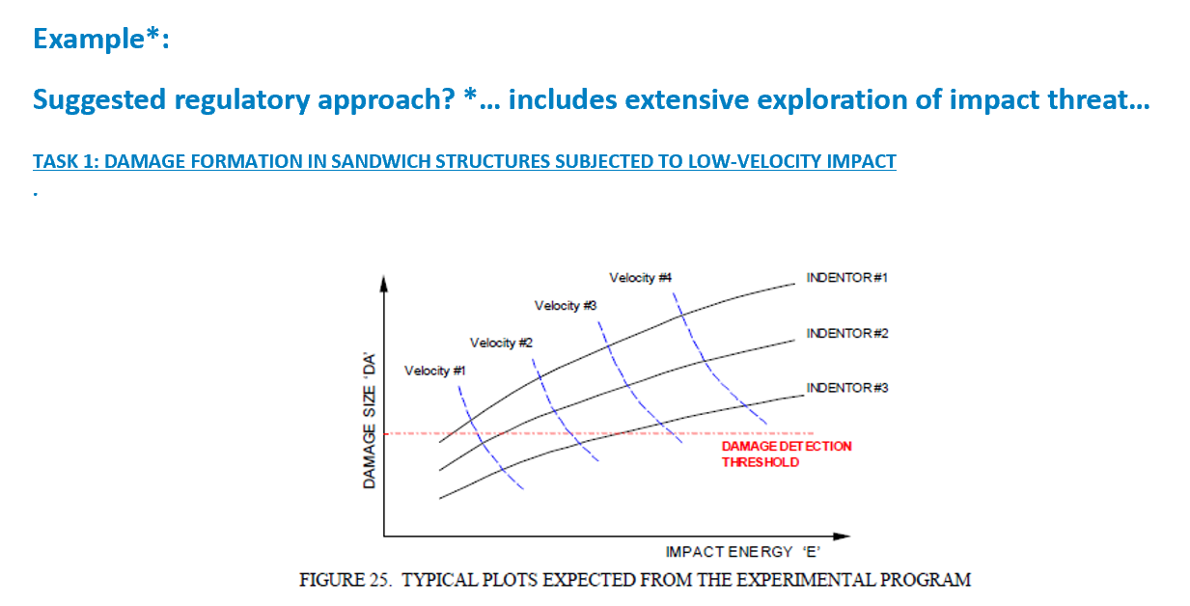
EASA – Composites
* e.g. DOT/FAA/AR-99/49 Review of Damage Tolerance of Composite Sandwich Airframe Structures

Slide 24
EASA – SAE CACRC
CS 25.302 Interaction of Systems and Structure:
For aeroplanes equipped with systems that affect structural performance, either directly or as a result of a failure or malfunction, the influence of these systems and their failure conditions must be taken into account when showing compliance with the requirements of Subparts C and D. Appendix K of CS25 must be used to evaluate the structural performance of aeroplanes equipped with these systems.
typically applied to load
management systems
571
S.Waite
Senior Expert - Materials
Certification Directorate571
applies to baseline structure, modifications, and repairs

Slide 25
EASA – SAE CACRC
CS 25.302 Appendix K25.1:
The following criteria must be used for showing compliance with CS 25.302 for aeroplanes equipped with flight control systems, autopilots, stability augmentation systems, load alleviation systems, flutter control systems, and fuel management systems. If this appendix is used for other systems, it may be necessary to adapt the criteria to the specific system.
However,
if SHM system is required to detect damage
e.g. to retain Ultimate Load capability,
then this could apply
e.g. ARP 6461 PLUS
considerable early project work with Regulator
to be expected…
571
S.Waite
Senior Expert - Materials
Certification Directorate571
applies to baseline structure, modifications, and repairs

Slide 26
EASA – SAE CACRC
Other regulations and guidance:
    EASA involved with/using evolving SAE SHM guidance ‘building blocks’:
ARP6461 'Guidelines for Implementation of Structural Health Monitoring on Fixed Wing Aircraft’
AIR6892 'Guidelines for Implementation of Structural Health Monitoring on Rotorcraft’
ARP6821'Guidance for assessing the Damage Detection Capability of Structural Health Monitoring Systems’
POD ‘White Paper’
SAE SHM ‘SHM Gap Analysis’
Also supporting guidance, e.g.
ARP4754 ‘Guidelines for Development of Civil Aircraft and Systems’
ARP4761 ‘Safety Assessment Process Guidelines & Methods’
ARP5150/5151 ‘Safety Assessment of Aircraft in Commercial Service’
ARP5987 ‘Process for Utilizing Aerospace Propulsion Health Management Systems for Maintenance’ Credit
571
S.Waite
Senior Expert - Materials
Certification Directorate571

Slide 27
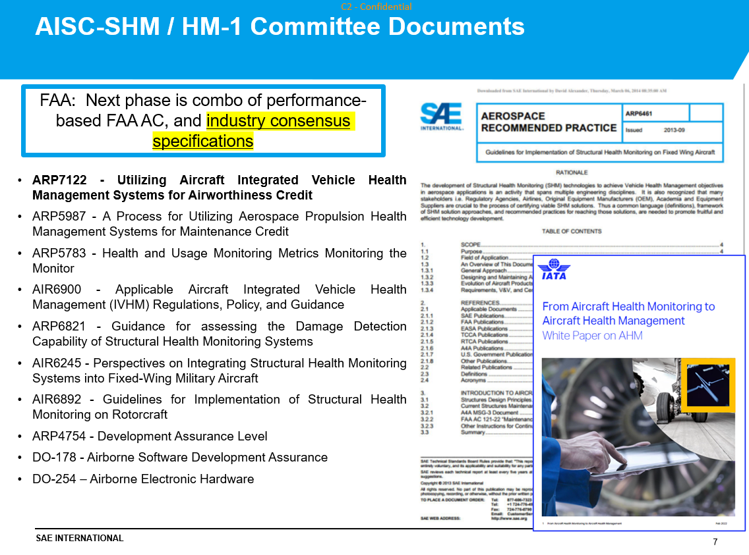
EASA – SAE CACRC
Other regulations and guidance:
571
S.Waite
Senior Expert - Materials
Certification Directorate571

Slide 28
EASA – SAE CACRC
Other regulations and guidance:
571
S.Waite
Senior Expert - Materials
Certification Directorate571
737NG Aft Bulkhead CVM

Slide 29
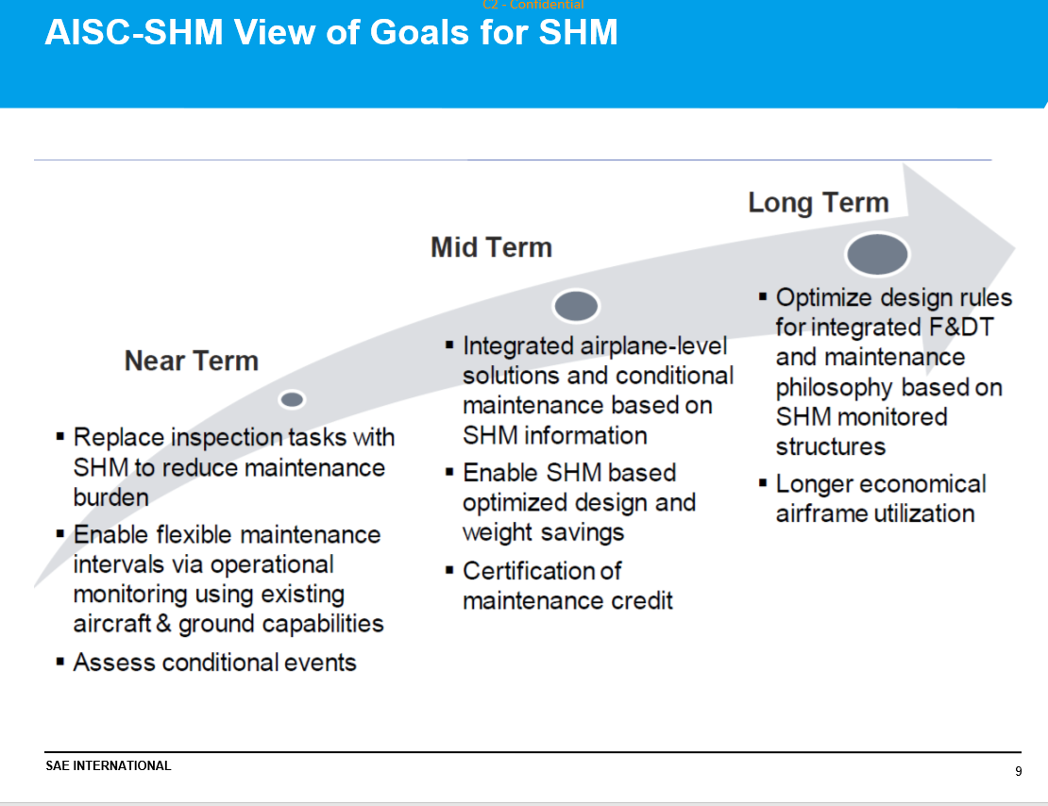
EASA – SAE CACRC
Other regulations and guidance:
571
S.Waite
Senior Expert - Materials
Certification Directorate571

Slide 30


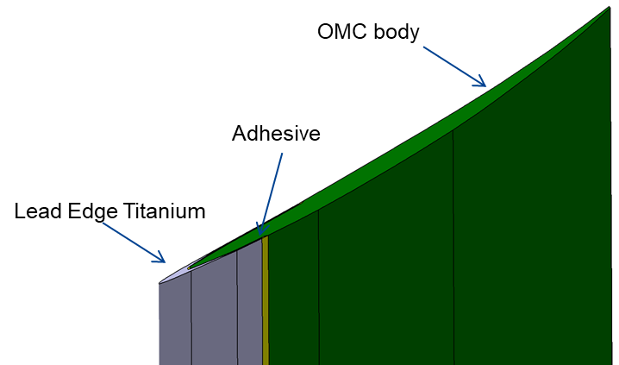
SHM – R&D
Example supporting European Union R&D:
‘Manufacturing, Overhaul, Repair for Prognosis Health Overreach’ (MORPHO) - Objective: ‘…proposes to embed printed and fiber-optical sensors in aircraft engine fan blades, thus providing them with cognitive capabilities already while they are manufactured. The parallel development of a digital/hybrid twin models will drastically improve the blades' Life Cycle Management (LCM). Particular focus lies on the efficient, profitable and environmental-friendly manufacturing, maintenance, and recycling of these next-generation smart engine fan blades.’
https://cordis.europa.eu/project/id/101006854

Slide 31
Questions ?

